Slide 1
Tool Use
CS6960 MultiModal LLM Agents
Kenneth Marino
Slide credits: Graham Neubig, Hanna Hajishirzi, others

Slide 2
Announcements
HW2 due in 3 weeks
A bit more complicated than past homeworks
Have some extra time
HW1
Still a few days left with late days+extension
Projects
(Soft) deadline for group formation - Feb 10
If you don’t have a group by then, please post on piazza w/ your project idea/interests to find groups (we can play a little matchmaking)
Participate in group activity Thur
Reach out to us if you have any questions/concerns

Slide 3
Any Questions

Slide 4
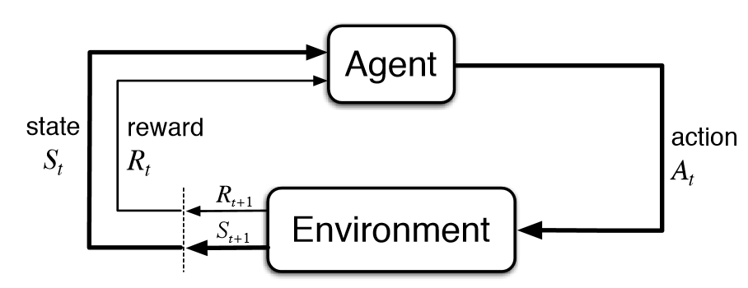
What does VLM agent actually look like?
VLM

Slide 5
What does VLM agent actually look like?
Input: text/images
VLM
Output: text (usually)

Slide 6
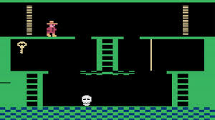
What does VLM agent actually look like?
Input: text/images
VLM
Output: text (usually)

Slide 7
What does VLM agent actually look like?
How to translate from text to other action spaces?
Input: text/images
VLM
Output: text (usually)

Slide 8




What is a Tool (for LLM Agents)?
An LLM-used tool is a function interface to a computer program that runs external to the LLM, where the LLM generates the function calls and input arguments in order to use the tool.
Slide credit: Graham Neubig

Slide 9
What is a Tool (for LLM Agents)?
Input: text/images
VLM
Output: text (usually)

Slide 10
What is a Tool (for LLM Agents)?
Input: text/images
VLM
Output: text (usually)
move_human(direction=left, duration_sec=1)

Slide 11
What is a Tool (for LLM Agents)?
Output of LLM is in space of text (easy for LLM/VLM to generate)
Input: text/images
VLM
Output: text (usually)
move_human(direction=left, duration_sec=1)

Slide 12
What is a Tool (for LLM Agents)?
Output of LLM is in space of text (easy for LLM/VLM to generate)
Input: text/images
VLM
Output: text (usually)
move_human(direction=left, duration_sec=1)
Tool call and parameters gives information needed by external tool to execute in the environment

Slide 13







Many Tool Functionalities
Perception: collect data from the env
Action: exert actions, change env state
Tools
Computation: general acts of computing
Slide credit: Graham Neubig

Slide 14
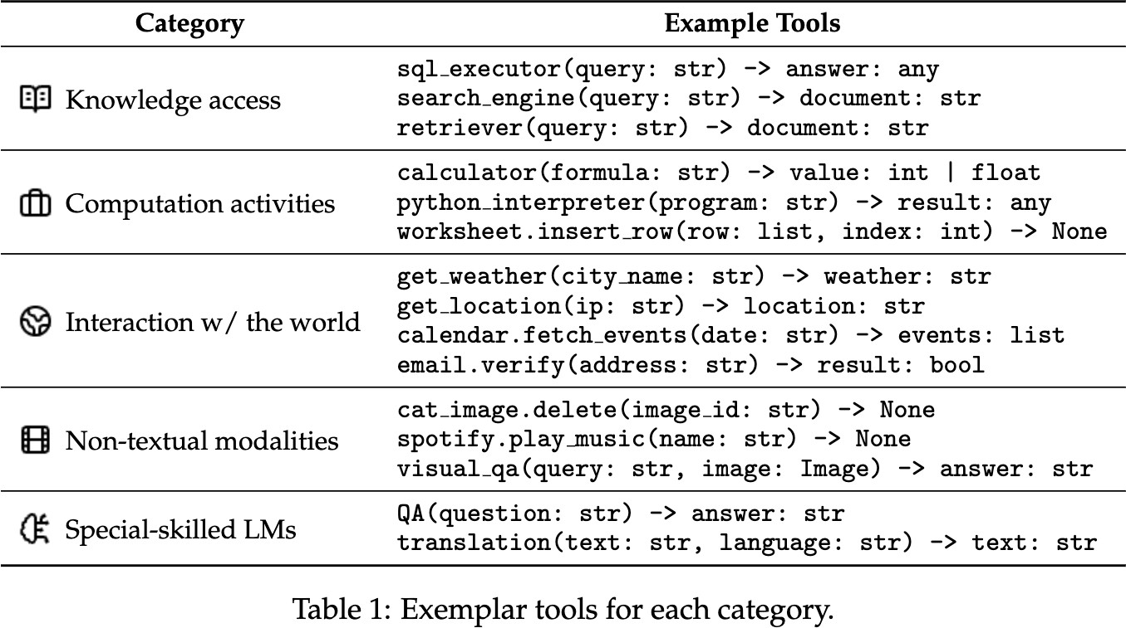
Tool Use Scenarios
Slide credit: Graham Neubig

Slide 15
Tool Use Scenarios
Retrieval can be thought of as a tool
Slide credit: Graham Neubig

Slide 16
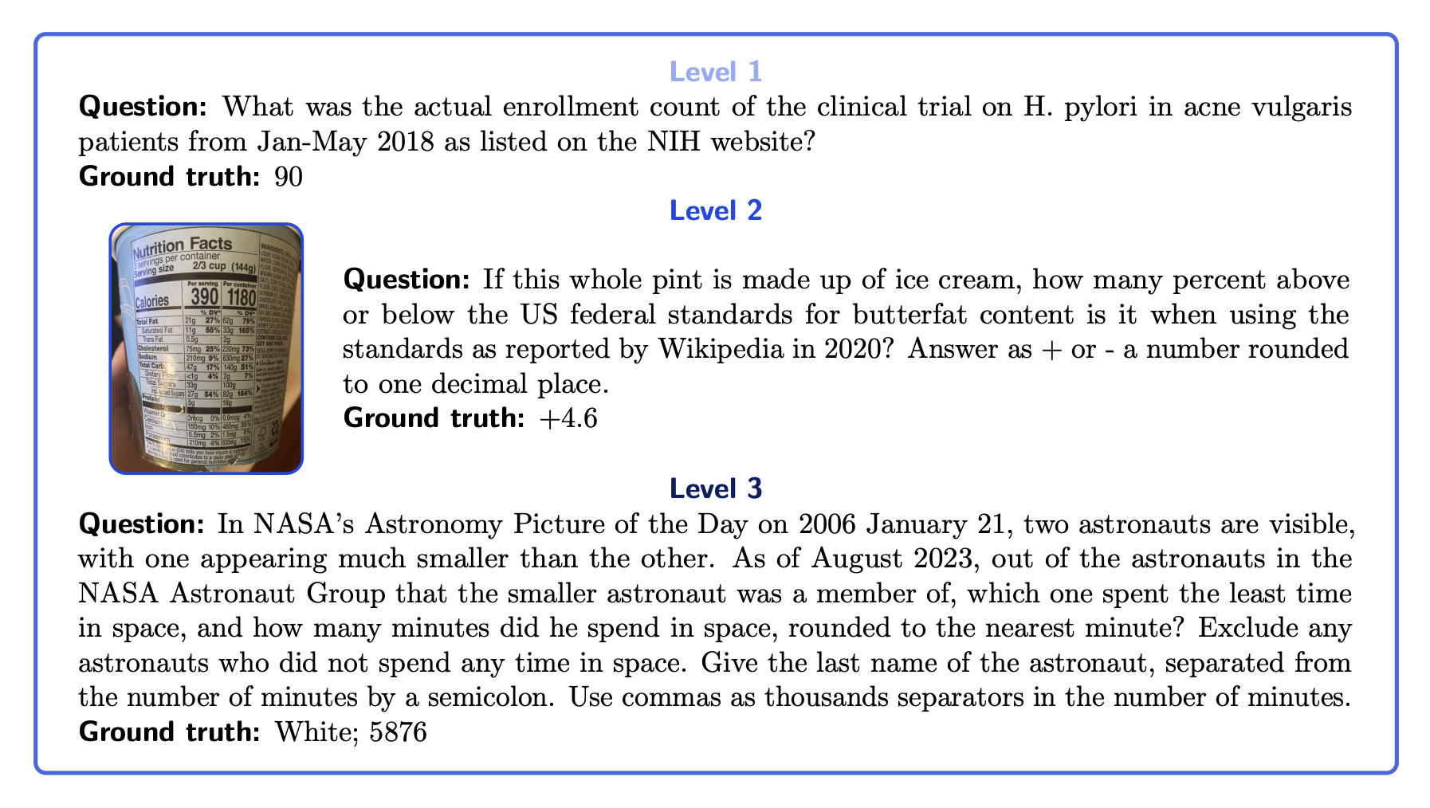

Recall: Retrieval as an agent tool
?
Notes:
Dan has a DEMO for this.

Slide 17
Define Custom Tools for Env
move_agent()
jump()
check_inventory()
get_enemy_location()
get_item_location()

Slide 18
Other Models Can Be Tools
call_vlm_detector()
Returns:
person (50, 50, 100, 100)
skull (200, 100, 250, 150)
key (25, 100, 75, 150)

Slide 19
Other Models Can Be Tools
planner_llm()
Returns:
First you should jump across the gaps to….

Slide 20
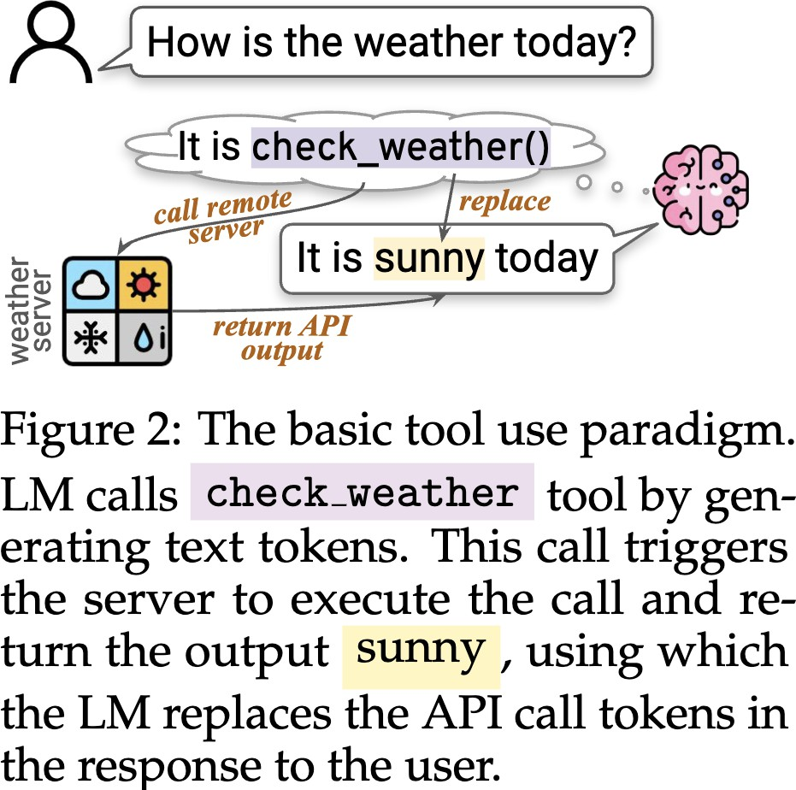
Tool Use Paradigms
Tool Use: switching between:
text-generation mode
tool-execution mode
How to induce tool use
Inference-time prompting
Training
Slide credit: Graham Neubig

Slide 21
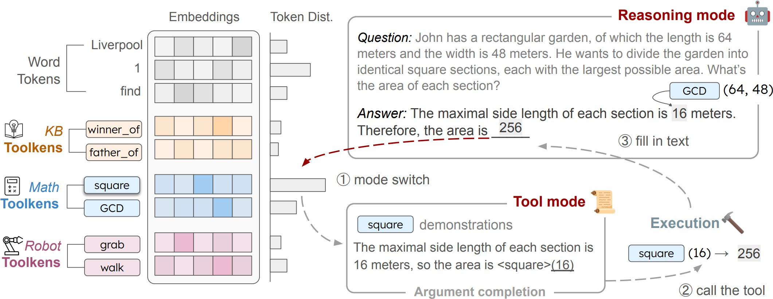
Tool Execution: Tool Tokens
e.g. ToolkenGPT (Hao et al. 2023)
Slide credit: Graham Neubig

Slide 22
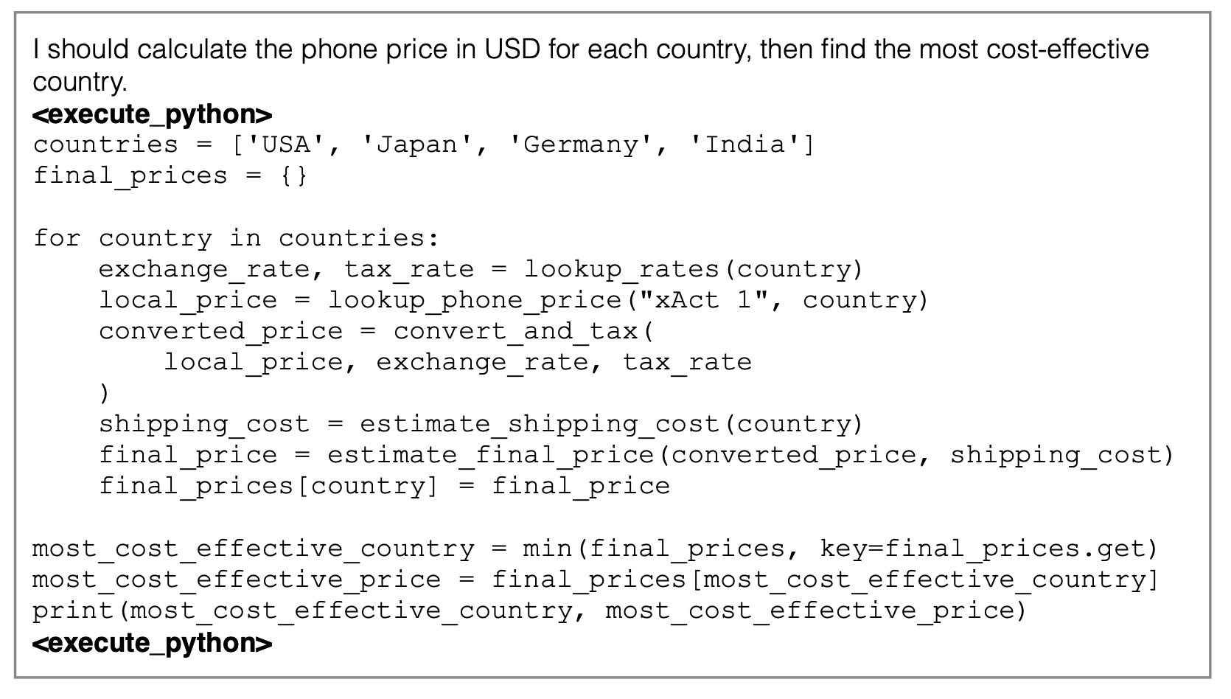
Tool Execution: Code Tags
e.g. ToolkenGPT (Hao et al. 2023)
Slide credit: Graham Neubig

Slide 23
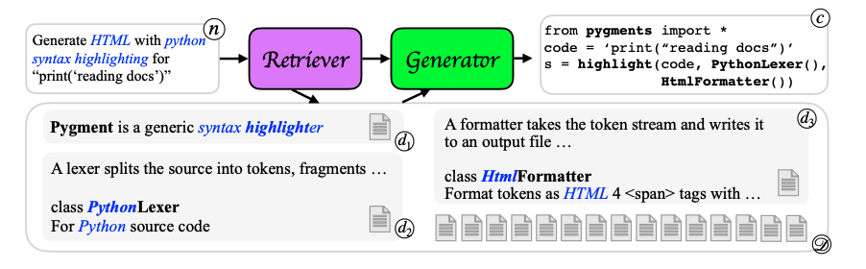
Prompting for Tool Use
e.g. DocPrompting (Zhou et al. 2022) retrieves library documentation
Slide credit: Graham Neubig

Slide 24
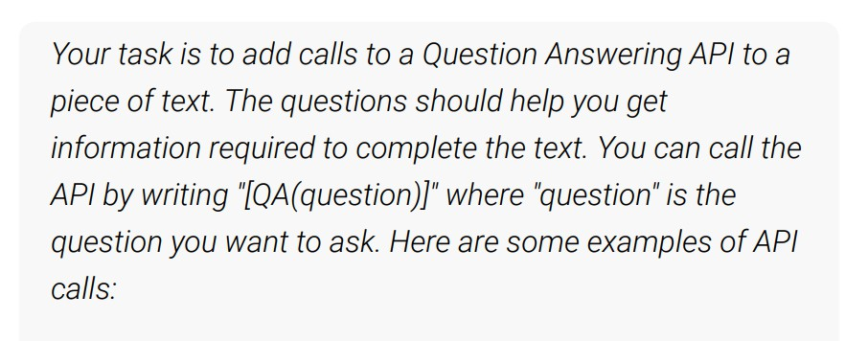
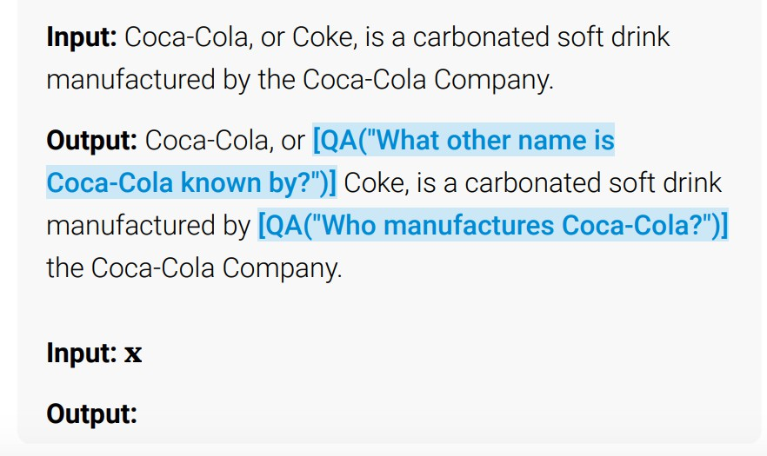
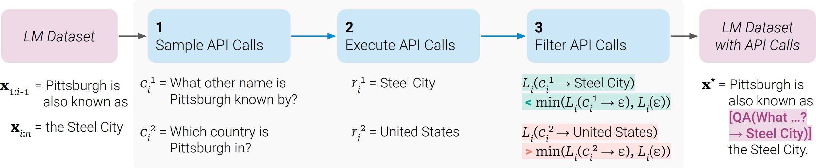
Learning for Tool Use
Prompt Unsupervised
Filter for Success and Train
e.g. ToolFormer (Schick et al. 2023)
Slide credit: Graham Neubig

Slide 25
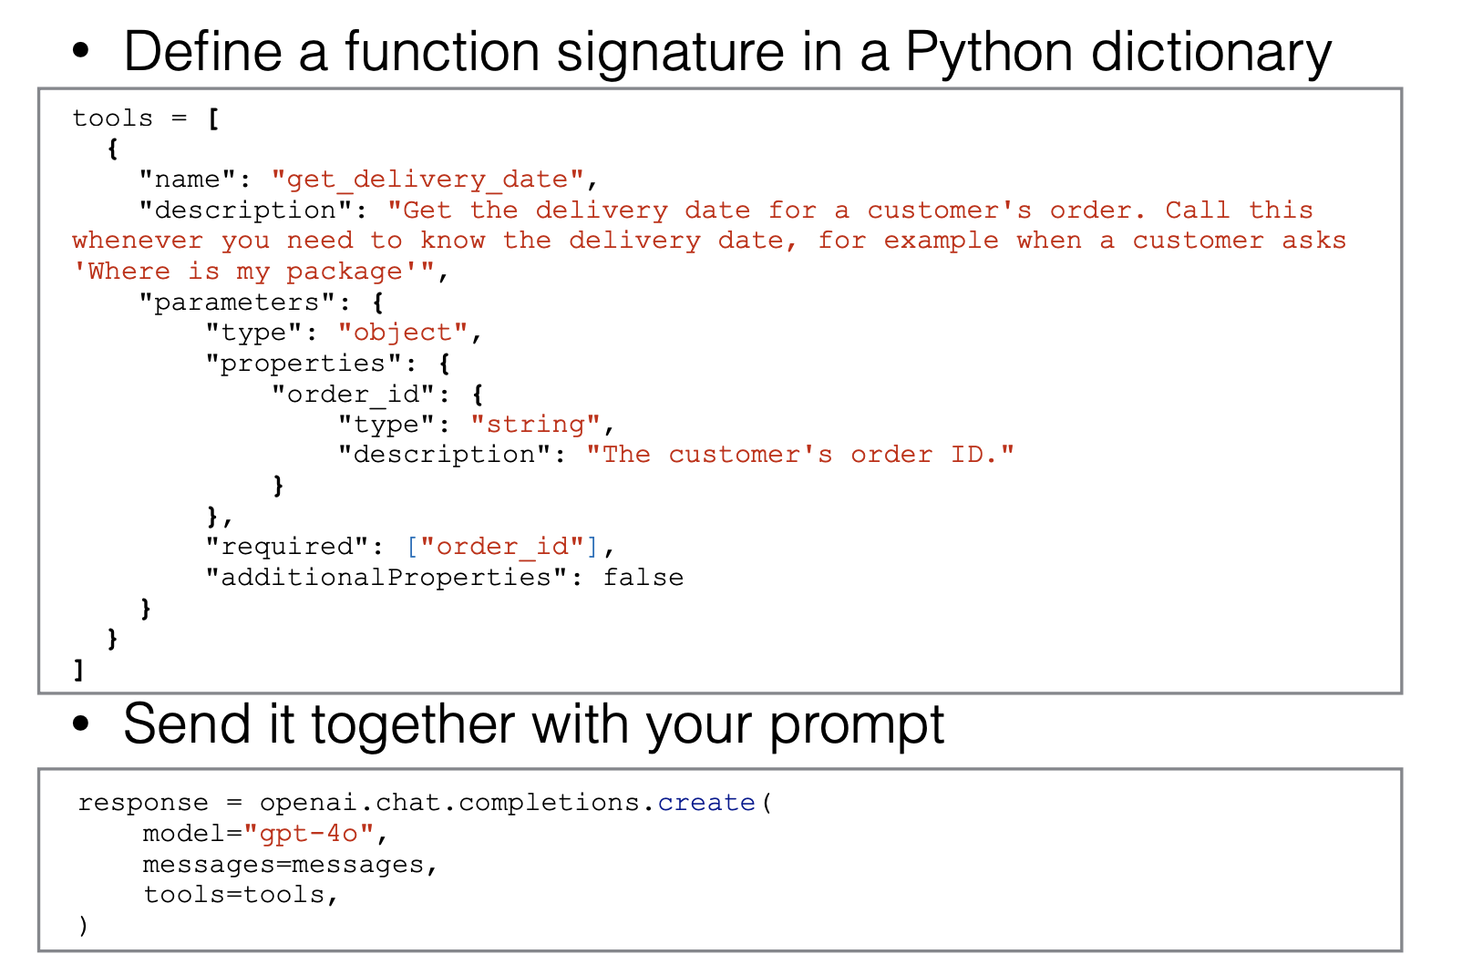
OpenAI Function Calling Standard
(OpenAI 2024)
Slide credit: Graham Neubig

Slide 26











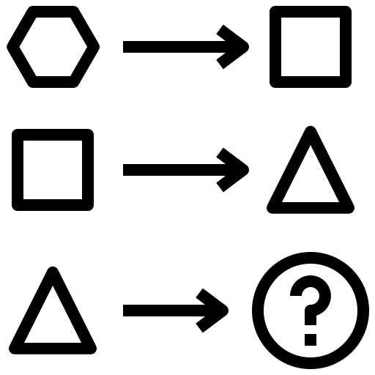
Modern LLMs: trained to use tools
Follow instructions
Serve apps
Chat
Pre-training
Post-training
Avoid harm
Use tools
Predict the next word in various contexts
Reason
Slide credit: Hanna Hajishirzi

Slide 27
Takeaways
Retrieval important part of agents
Tools
A way of going from language to *some other* space
Can be used for taking actions, getting new input/observations, calling other models
A useful interface to the world
Lots of ways of doing it
Using special tokens
Using code
How to get to work
Pure prompting
Trained
Virtually all LLMs/VLMs trained to use tools in some way

Slide 28

Any Questions
Questions

Slide 29
Now for the presentations!

